Slide 1

ML Team 4 Work
June 2020 Session
Forum post classification into a specific category

Slide 2
ML team 4
Project Lead: Sara El-Ateif
PM Lead: Rohit Ganti
Participants: Kevin Dong, Gabriel Jai, Zoey, Khushali Verma, Ananya De, Mutaz Ahmed, Kitty Gu, Wei Huang
Observers: Shalini Kumari, William Phillips, Merron Tecleab, Xuchen Fang
14 interns : 2 lead, 8 participants, 4 observers
Please check our profiles in STEMAway Forum.

Slide 3
AGENDA
Introduction
Project Outline
Data Collection & Processing
Basic Data Modeling
Advanced Data Modeling
Results Discussion
Conclusion
Notes:
Introduction [Team presentation with context of the internship,goal of the project and its benefits]
Project Outline [General outline/workflow of the work done]
Data Collection & Processing [Team Flowster and Team Amazon work from the site map to the initial data preprocessing performed]
Basic Data Modeling [Talk about the different models, EDA and preprocessing as well as feature engineering performed for each team] and its results add the TF-IDF part on the whole data as well.
Advanced Data Modeling [Detail training using BERT as embedding + LR model in comparison with TF-IDF as embedding + LR model, Mention Tuning the model and its results, Mention Data Augmentation and its results]
Results Discussion [Mention the best result and discuss why you think it’s the best]
Conclusion [Criticize the results and propose improvements or things you would like to try]

Slide 4
Introduction

Slide 5
Executive Summary
Problem:
From time to time when authors are publishing their posts on online forum, they are unsure which category should they fall into.
Solution:
Built a system to classify a given post from a specific forum from the E-commerce DiscourseHub Community into its appropriate category.
Result:
The model yielded an 81% accuracy.

Slide 6
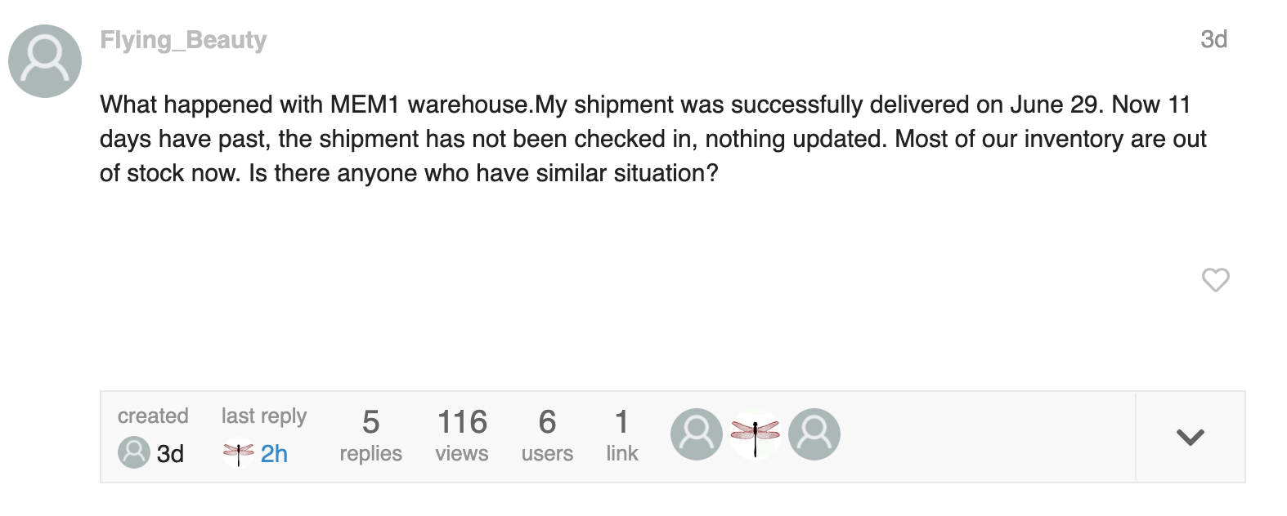
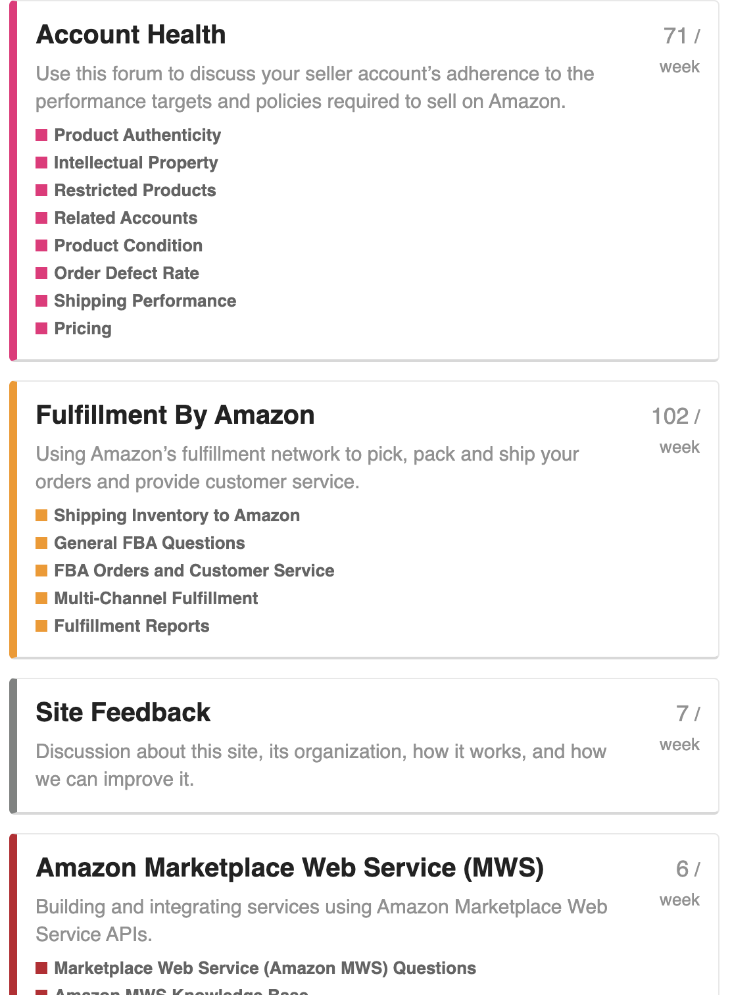


Problem Context
But there are so many categories!!
A user is about to publish a post on an online forum
Only if there is a feature to suggest an appropriate category for his post automatically
Which category should he label his post?

Slide 7
Project Outline

Slide 8
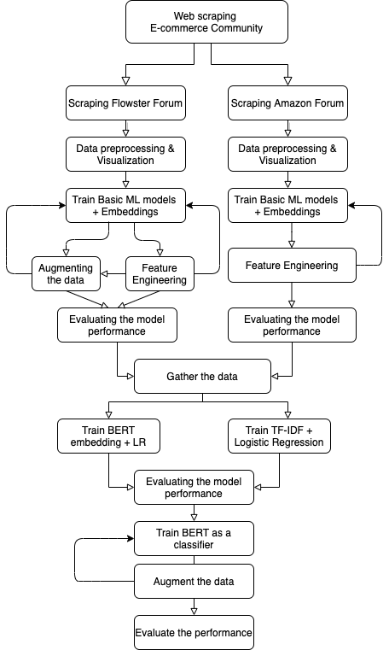
Project Workflow

Slide 9
Data Collection
& Processing

Slide 10
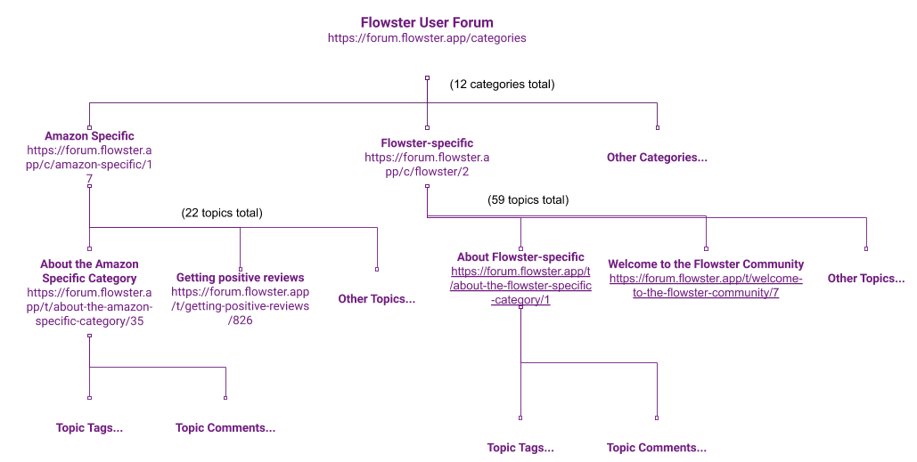
Discourse Forum Site Map Example
The Flowster and Amazon Seller forums both share the same structure

Slide 11


Python libraries used for web scraping
BeautifulSoup and Selenium were used for the web scraping task
Python library for extracting data from HTML/XML web pages. One of the most common tools for web-scraping as it is very user friendly and easy for beginners to understand the logic behind web scraping.
Python library for web browser automation, used in addition to BeautifulSoup for its efficiency at extracting JavaScript data. This enabled us to extract more information from the forums in an efficient manner.
Notes:
Web-scraping libraries Selenium and BeautifulSoup were used to extract information from the forums
For each topic in each category, the following attributes were collected: topic title, category, tags, author, leading comment and reply comments
The raw text information was stored in two CSV files for later data cleaning and processing
For deep learning models, we merged both the Amazons and Flowsters data into one CSV file

Slide 12
Flowster Data
Exploratory Data Analysis (EDA)

Slide 13
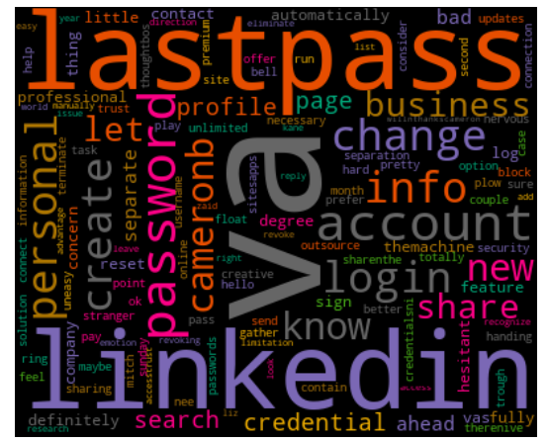
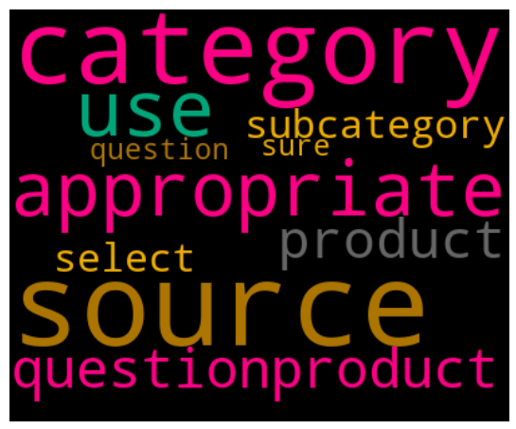
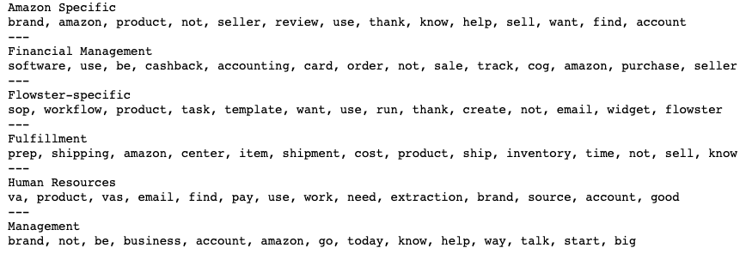
Generated Word Clouds and lists of frequent words
Popular Post
Unpopular Post
Notes:
Sara’s interpretation: The popular section is all about creating an account and security concerns; As for the unpopular section they are asking for reviews about products.

Slide 14
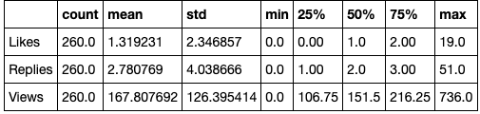
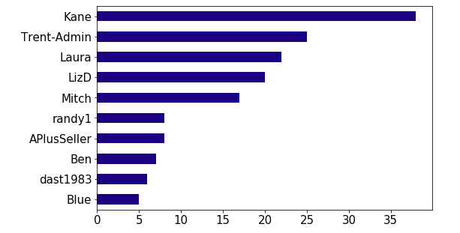
Relatively Low Activity of the Flowster Forum

Slide 15
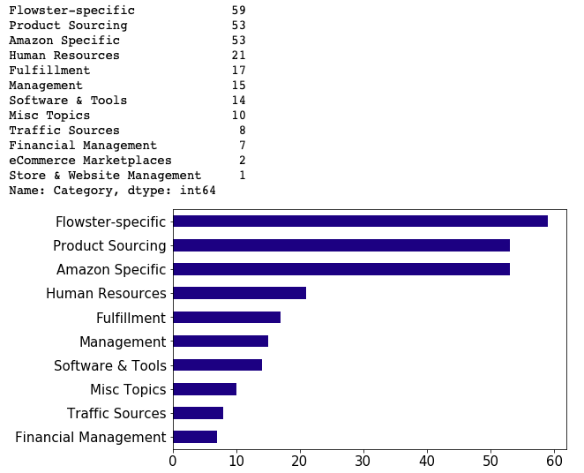
Class Imbalance
Need to be taken into account when training classifiers.

Slide 16
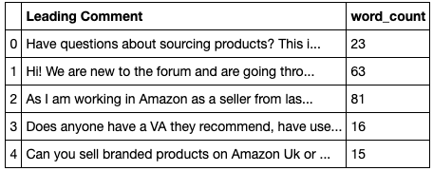

Many Stop Words
Implied that removing stop words may have hurt the accuracy of our analysis

Slide 17
Data Cleaning Techniques
Data augmentation by turning the topic reply comments into “new” topics within the same category
Lowercase normalization
Punctuation removal
Stopword removal
Rare word removal
Non-ASCII character removal
Numerics and cost replacements using unique identifiers “########” and “$$$$$$$$”

Slide 18
Amazon Data
Exploratory Data Analysis (EDA)

Slide 19
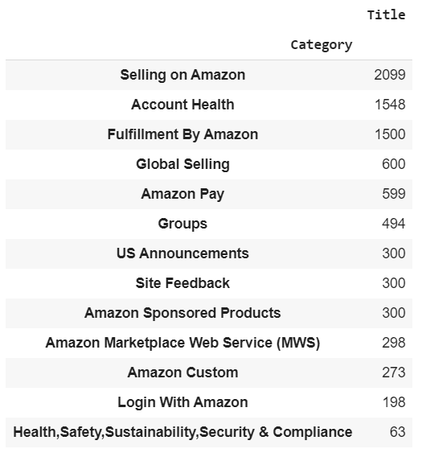
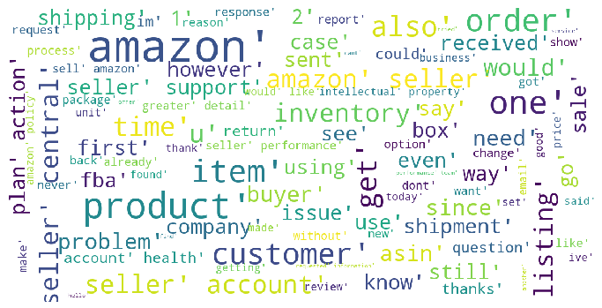
Class Imbalance
Generated Word Map:
Class imbalance for the amazon data was less drastic than that of the flowster’s data.

Slide 20
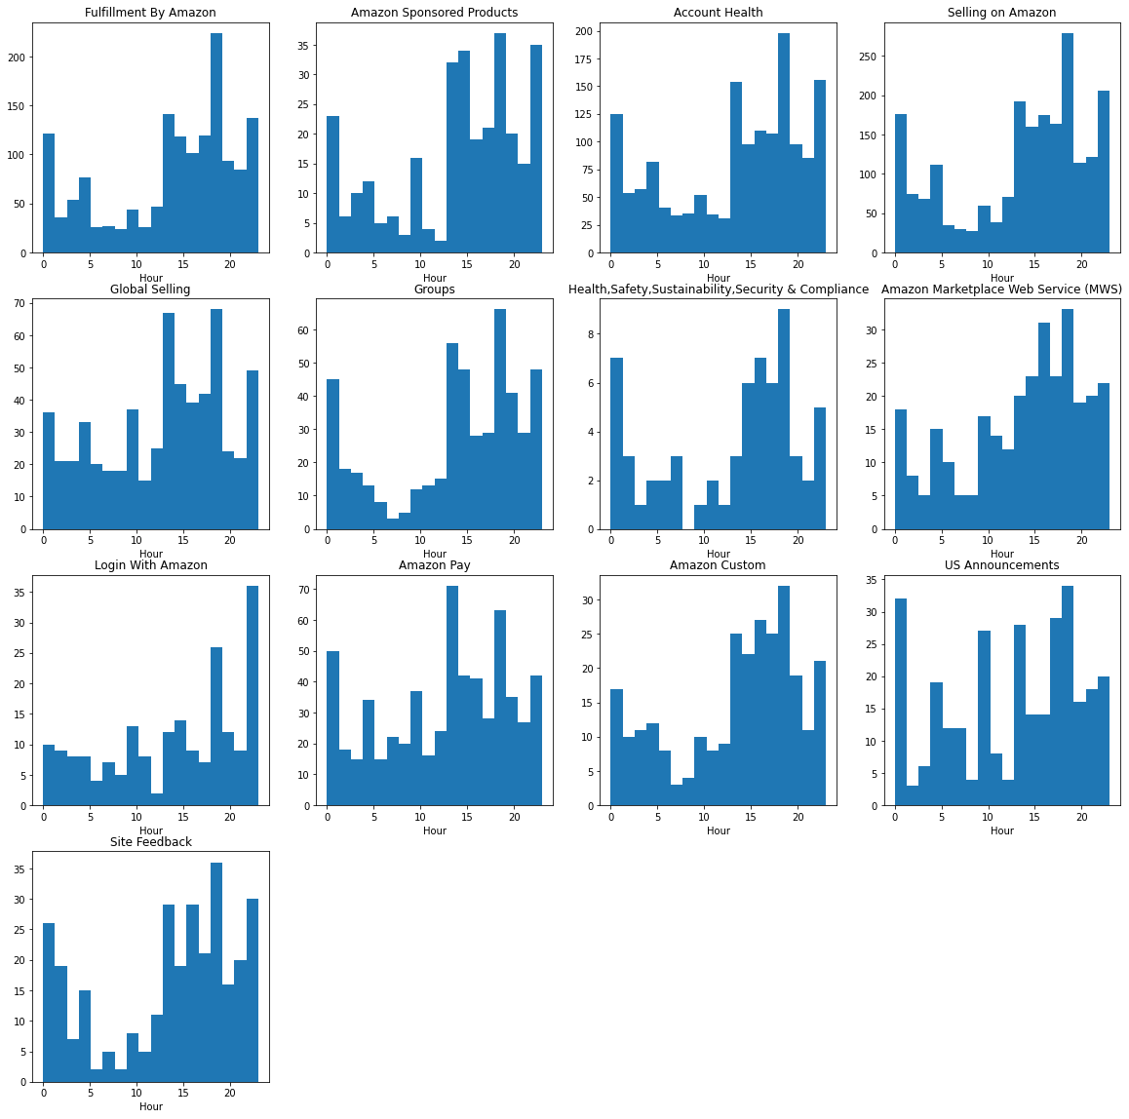
Numeric features do not seem helpful in distinguishing categories
Most of the posts in every category possessed a similar pattern in numeric features.
For example, the majority of posts was published in the afternoon and evening.
Because they were very similar, it would not be very helpful to use the numeric feature as one of the predictors.

Slide 21
Data Cleaning Techniques
Lowercase normalization
Punctuation removal
Stopword removal
Non-ASCII character removal
URL removal

Slide 22
Basic Data Modeling

Slide 23
Models & Embeddings Experimented
Word embeddings
Bag of Words (Count Vectorizer)
TF-IDF
Word2Vec
Doc2Vec
Basic ML models
Naive Bayes
Linear SVM
Logistic Regression
XGBoost
Random Forest
LightGBM

Slide 24
Flowster Data
Basic Data Modeling

Slide 25
ML Models vs Text Embeddings Performance
 | Bag of Words | TF-IDF | Word2Vec | Doc2Vec
Linear SVM | -- | 0.55, 0.78 | -- | 0.6
Logistic Regression | 0.85 | 0.51, 0.83 | 0.19 | 0.68, 0.55
Naive Bayes | 0.59 | 0.59, 0.48 | 0.11 | 0.29

Slide 26
TF-IDF+Linear SVM with various data preprocessing
Data Preprocessing | Augmentation | Accuracy
Lowercase all words + Lemmatization + Remove digits, words containing digits, extra spaces, punctuations, rare words, common words, stop words lemmatization | NO | 51%
Lowercase all words + Remove digits, words that contain digits, extra spaces, punctuations | NO | 56%
Remove punctuations and stop words + Lowercase all words | YES | 78%
Notes:
A specific report(don’t know if it is needed)

Slide 27
Amazon Data
Basic Data Modeling

Slide 28
ML Models vs Text Embeddings Performance
 | CountVectorizer + TF-IDF Transformer
Naive Bayes Classifier - Multinomial NB | 0.49
Decision Tree | 0.58
Random forests | 0.69
Logistic regression | 0.73
Linear SVM - SGDClassifier | 0.74
These are the best results obtained with different preprocessing techniques and fine tuning performed.

Slide 29
ML Models vs Text Embeddings Performance
 | CountVectorizer | TF-IDF | Doc2Vec
Logistic regression | 0.68 | 0.72 (Accuracy) | 0.29
Random forests | -- | 0.74 (Cross Validation) | 0.22
XGBoost | -- | 0.74 (Cross Validation) | 0.27
Light GBM | -- | 0.70 (Cross Validation) | --
These are the best results obtained with different preprocessing techniques and fine tuning performed.

Slide 30
Advanced Data Modeling

Slide 31
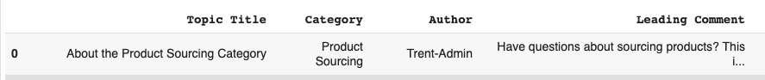
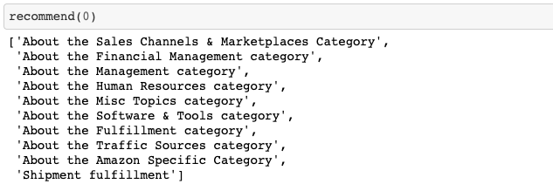
Understand DistilBERT (embedding) + Similarity Calculation
Key Takeaway:
DistilBERT took into account the context of the topic, which is used when performing classifications.
Notes:
Built a recommend function (trained with DistilBERT embedding) that takes in the index of the topic and gives a list of 10 most similar topics as recommendations.
Can you launch LWA webpage inside the app, and not in Safari on iOS?",Login With Amazon,PShizzle,"Hi!
We are integrating with Login-With-Amazon but don’t find the experience of launching Safari to to actually login with amazon credentials as a seamless experience. Is there a way to tell LWA sdk to launch inside our iOS app and not launch in Safari?
Thanks!","['Hello,\nThank you for your interest in our product. At this moment, we do not support seamless sign-in experience on IOS. That is to say, customers would always need to sign in to your IOS App through their default browser. The reason behind is that browser based sign-in process provides better protection for Amazon customers’ account credentials.\nHowever, we do understand seamless sign-in experience is a valuable use case. Therefore, we will continually work on improving our product to provide better user experience for both Mobile App developers and customers.\nThank you.',
5194,ShipWorks,Amazon Marketplace Web Service (MWS),CavemanFoods,"Hello, we are trying to link our ShipWorks account with Amazon Seller Central. We need the Seller ID:, Auth Token:, and Marketplace ID…
We get into the set up and we get these options:
image.png790×200 32.6 KB
We can’t find ShipWorks in the app store.
So is this a private app where we need to fill out all of their information and make sure we are complying with the privacy requirements?
Anyone else using ShipWorks or something similar where this has come up?
Thanks!","['I would really advise against providing your credentials to a third party developer/company. The way Amazon handles this is that they need to provide you with their developer id so that you may authorize them to get access to your account. This way you can revoke their privileges at any time.', 'CavemanFoods:\n\nWe need the Seller ID:, Auth Token:, and Marketplace ID…\n\n\nFYI This link says your Merchant Token is also known as your “seller identifier”\nhttps://sellercentral.amazon.com/gp/help/48321\nYour Merchant Token (aka Seller ID) is found here:\nhttps://sellercentral.amazon.com/sw/AccountInfo/MerchantToken/step/MerchantToken\nYour Marketplace ID is here (choose one depending on country):\nhttp://docs.developer.amazonservices.com/en_US/dev_guide/DG_Endpoints.html\nYou need to get the MWS Developer ID of ShipWorks, then authorize the ShipWorks Developer ID to access your seller account. You add their Developer ID to your seller account here::\nhttps://sellercentral.amazon.com/apps/manage\nAfter their Developer ID has been authorized to access your seller account, the “MWS Auth Token” is created and is available on that same screen. Press the “View” button to seen that value.\nDavid Nelson\nDynamic Enterprise Technologies Inc\nSeattle Washington USA', 'If you google\nshipworks adding amazon store\nyou will find a nice support document to setup your amazon account integration. You do not need to get developer credentials, you will go through the manage app screen and use the ‘Authorize New Developer’ button to change their developer id into an auth token and sellerid to put back into their forms.\nEDIT: another new updated screen messing with everyones docs', 'Autonomoose is right, the help file is pretty straight forward. If you hit a roadblock, call Shipworks.', 'This topic was automatically closed 180 days after the last reply. New replies are no longer allowed.']"
1,Price Checker 2 - Competitor storefront extraction,Product Sourcing,MoniqueAndKerry,"Hi! We are new to the forum and are going through the Product Sourcing for Professionals SOPs. We have a question on the Product Extraction workflow process using PC2: we have downloaded the free version and it doesn’t have the button that says ‘Amazon Browser/Searches’. Do we need to purchase the full PC2 package to get this feature?
Thanks for your help in advance!","['Yes you will need the paid version. Options for extraction tools include PC2, Tactical Arbitrage, and Helium10. All require a paid version to run at scale.']"

Slide 32
Fine-Tuning the BERT model
Parameters (batch_size=8) | Accuracy
Max_seq_length = 128 Num_train_epochs = 4.0 | 67%
Max_seq_length = 256 Num_train_epochs = 3.0 | 68%
Max_seq_length = 512 (442 tokens from head, 70 tokens from tail) Num_train_epochs = 3.0 | 68%
Max_seq_length = 512 Num_train_epochs = 3.0 | 68.7%
Max_seq_length = 512 Num_train_epochs = 4.0 | 70%

Slide 33
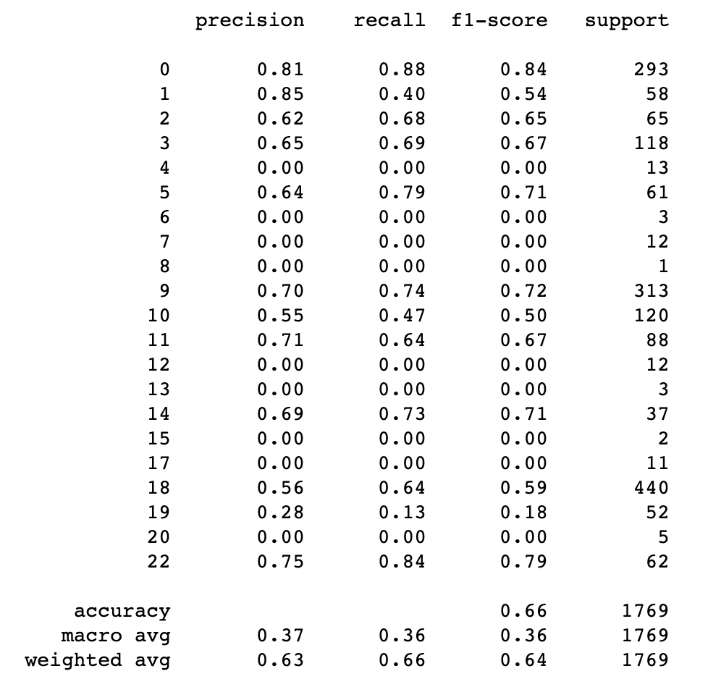
A Problem of BERT
Despite the model yielding decent results for most categories, it had difficulty of identifying specific characteristic of categories with less data
In order to address this issue and improve the performance of the model, data augmentation would seem to be needed

Slide 34
After augmenting the data

Slide 35
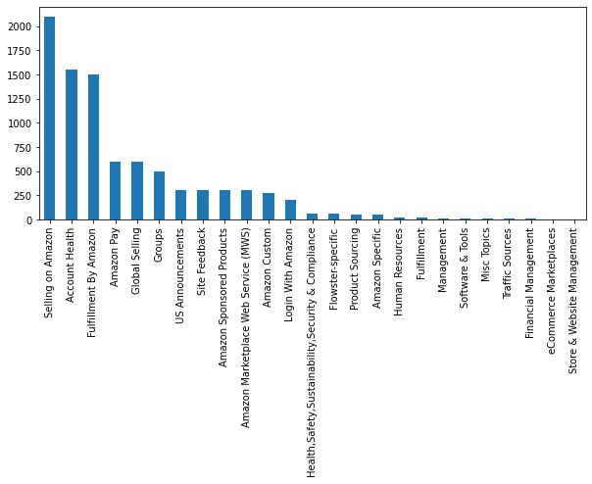
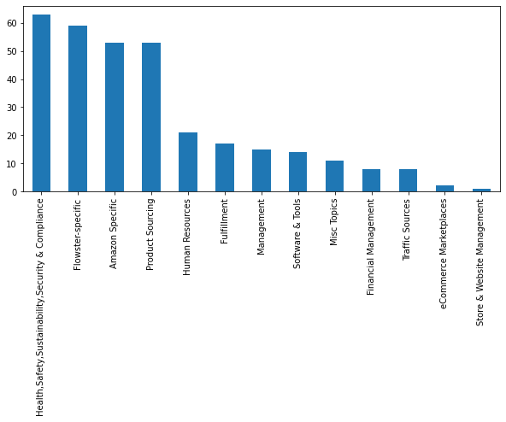
Class Imbalance
1st graph: All categories
2nd graph: Categories with data < 250 sample
Class Imbalance
Our dataset suffers from the class imbalance problem in a distinguished manner as shown in the 1st graph.
As the 2nd graph demonstrates we have 12 categories with data less than 250 samples.

Slide 36
Training with different data processing methods
Method 1: Training without categories that have small amount of samples
Method 2: Training with data augmented (by substitution) on categories that had small sample size (<250) using TF-IDF, Roberta, BERT, DistillBert, WordNet, GPT-2 using nlpaug library
Method 3: Training by first transforming and incorporating the reply comments into leading comments, and then augmenting (by substitution) this new dataset by using BERT, DistillBERT and WordNet using nlpaug library
Method 4: Training with data augmented by round-trip translation (RTT). Multiple rounds of RTT were performed on leading and reply comments to increase the sample numbers of the unbalanced categories.

Slide 37
Data Augmentation and Dropping Effects
Parameters (batch_size=8, max_seq_length=512, epochs=4) | Accuracy
Method 1: Dropping categories with less data | 72%
Method 2: Augmenting using TF-IDF, Roberta, BERT, DistillBert, WordNet, GPT-2 | 4%
Method 3: Incorporating the Reply Comments into Leading Comments, followed by augmenting the new data by using BERT, DIstilBERT and WordNet | 78%
Method 4: Augmenting using RTT | 81%
Notes:
Fine-Tuned TF-IDF + Logistic Regression Results
Strategy
Accuracy
Augmented Data using method 1 formula
69%
Augmented Data using method 2 formula
88%

Slide 38
Results Discussion

Slide 39
Data Augmentation Results Discussion
Method 2
Using TF-IDF, Roberta, BERT, DistilBert, WordNet, GPT-2 from nlpaug library decreased the accuracy to a worrying level and this could be due to the noise they introduced to the data.
Example: Using 'roberta-base'
Original:
Have questions about Store & Website Management? This is the category to use. Please be sure to select the most appropriate sub-category for your questions.
Augmented Text:
[' FDA is asking me to send them with a registration of my products I did submit them a schedule but they said it � � d not the correct one . I buy the ingredient of the products from a man u af act urer , then I rep ack aged them and sell . I have know idea on how they get on the FDA website because they only allowed me to register a small facility .

Slide 40
Data Augmentation Results Discussion
Method 3
Training by first transforming and adding the Reply Comments as Leading Comments and then augmented (by substitution) this new data by using BERT, DistilBERT and WordNet using nlpaug library.
This approach was less noisy in comparison with the previous one as we can see from the following example.
Example: Using ‘wordnet’
Original:
['Amazon is asking me to provide them with a registration of my product. I did submit them a registration but they said it’s not the correct one. I buy the ingredient of the capsules from a manuafacturer, then I repackaged them and sell. I have know clue on how to register on the FDA website because they only allowed me to register a food facility. Please help me!!!']
Augmented Text:
Amazon is asking me to provide them with a registration of my product . I did relegate them a enrollment but they said it ’ s not the correct one . I corrupt the ingredient of the capsules from a manuafacturer , and then 1 repackaged them and sell . I sustain jazz clue on how to register on the FDA website because they only allowed me to register a food facility . Please help me ! ! !

Slide 41
Data Augmentation Results Discussion
Method 4
Round-trip translation (RTT) augmentation using googletrans proved to be challenging and time-consuming due to the low reliability of the API in translating sentences back into English. Nonetheless, this approach was the most effective at producing augmented texts which are semantically correct.
Two examples of RTT augmentation (original text shown in the first set of brackets):

Slide 42
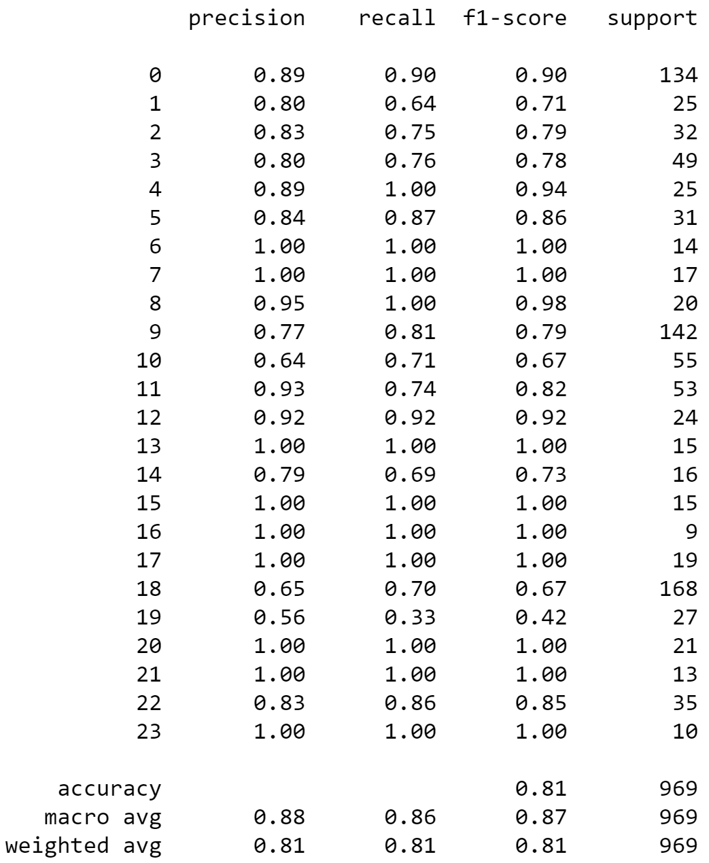
Data Augmentation Results Discussion
RTT augmentation also had the advantage of being able to be applied in several rounds, thus increasing the amount of potentially diverse texts from the different language combinations.
Despite this theoretical advantage, however, it was noticed that over-usage of the the method on short sentences produced nearly identical outputs. Thus, categories requiring high amounts of augmentation saw an artificial increase in accuracy (shown on the right), possibly driven by the data bias.
Nonetheless, the RTT method proves to be a valuable tool in improving model performance, even on non-augmented categories.

Slide 43
Conclusion

Slide 44
Shortcomings & Improvements
Shortcomings:
The model still mis-classifies some classes
Data quality
Improvements:
Explore different tokenization process
Fine tune BERT learning rate and batch size parameters
Improve the data augmentation process
Improve the recall score
Improve data quality
Notes:
Use the model to improve data quality.
System that monitors new added posts into the forum and adds them to the database automatically to train the model later on.

Slide 45
Thank you!
Any Questions?

